Slide 1
INTRODUCTION LECTURE # 1

Slide 2
Fair Use Notice
The material used in this presentation i.e., pictures/graphs/text, etc. is solely intended for educational/teaching purpose, offered free of cost to the students for use under special circumstances of Online Education due to COVID-19 Lockdown situation and may include copyrighted material - the use of which may not have been specifically authorized by Copyright Owners. It’s application constitutes Fair Use of any such copyrighted material as provided in globally accepted law of many countries. The contents of presentations are intended only for the attendees of the class being conducted by the presenter.

Slide 3


What Is Profession?
A profession is something a little more than a job, it is a career for someone that wants to be part of society, who becomes competent in their chosen sector through training, maintains their skills through continuing professional development , commits to behaving ethically and to protect the interests of the public.
It must demand adequate pre-professional and cultural training.

Slide 4
The Qualities Of A Profession
A profession applies its body of knowledge in practical services that are vital to human welfare and especially suited to the tradition of seasoned practitioners shaping the skills of newcomers to the role.
A profession has a clear standard of educational preparation for entry onto practice.

Slide 5
The professions are for you if you want...
An occupation which will help you to build your skills and develop your expertise in a field which interests you.
To keep learning, be challenged and stay up to date with the latest developments in your chosen area.
To solve problems, do good work, and be involved in making decisions which help to improve people’s lives.

Slide 6

Key Differences Between Occupation & Profession
The major differences between occupation and profession are discussed as under:
An activity performed by a person normally for monetary compensation is known as the Occupation. Profession refers to , in which high degree of education or skills is required.
Unlike occupation, the profession has a code of conduct.
In general, the profession is regulated by a particular or professional body statute while an occupation is not.
A person doing occupation get paid for what he produces, whereas a profession gets paid according to his knowledge and expertise.
The profession is also an occupation when the person is paid for utilizing his skills and expertise.
There are some responsibilities which are associated with the profession. However an occupation is not backed with such responsibilities.

Slide 7
Key Differences Between Occupation & Profession (Cont…)
The basic pay in the profession is normally higher than in occupation.
The professionals are respected by people and have a high status in the society as compared to the occupation.
TO conclude it can be said that the occupation is a broader term, and it includes profession. While occupation also includes those jobs that are ordinary and hence, they don’t get high recognition from the society, Professionals are mainly known by their jobs, and that is why they receive a high level of respect and recognition from the society.

Slide 8
What Is Professional Practice ?
Professional practice: The term 'professional practice' refers to the conduct and work of someone from a particular profession.
Professional bodies may set standards of ethics, performance, competence, insurance, training and so on that must be met to remain within the profession.
Professional practice is the way an individual behaves in the workplace.
Professional Practice is concerned with the knowledge, skills and attitudes that Software Engineers must possess to practice software engineering in a professional, responsible and ethical manner.

Slide 9
Aims Of Professional Practice
To provide students with the opportunity to actively participate in planning, developing and implementing specific programs related to different methods in professional carrier.
To improve their knowledge of their specialization gained in the course of their studies, to strengthen their competences expected in their specialization.
To acknowledge the expectation regarding different positions, to get to know rules related to work to be aware of the importance of accurate work and keeping deadlines.
To help students to learn a way of thinking specific to their specialization and to their problem-solving skills.

Slide 10
Aims Of Professional Practice (Cont…)
To increase their efficiency both in individual and teamwork based on their general competences,
To improve their communication skills
To adapt their preciously gained knowledge and to get to know new tools depending on their workplace

Slide 11
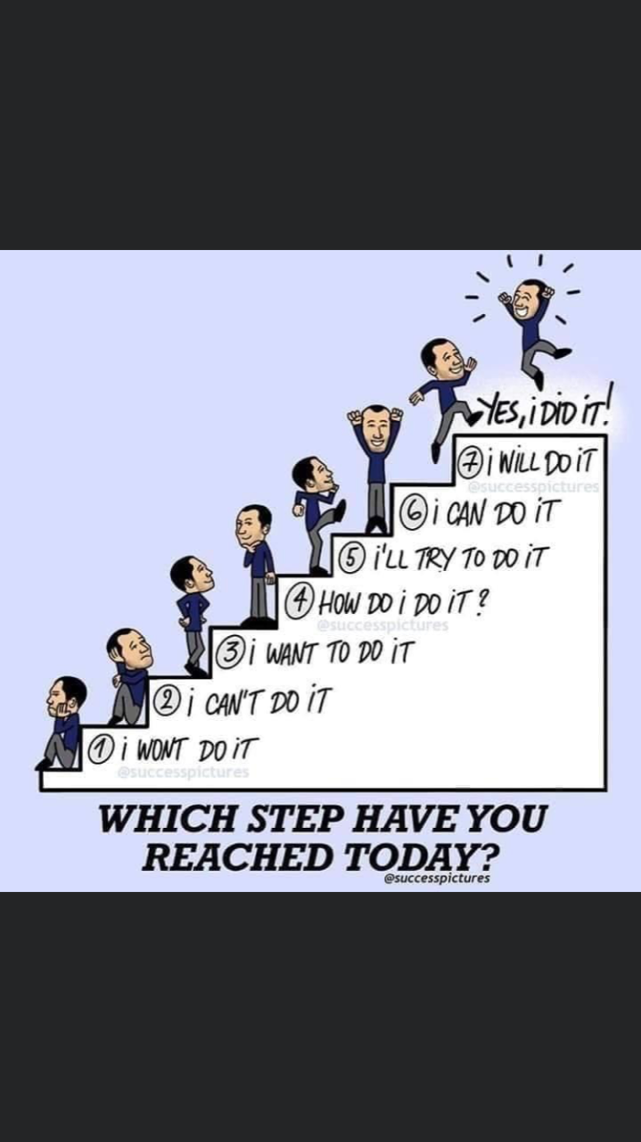
Lesson For Life

Slide 12
Thank you… Questions….??? If Any…

